Slide 1
Protein function classification via support vector machine approach
C.Z. Cai, W.L. Wang, L.Z. Sun, Y.Z. Chen
Mathematical Biosciences 185 (2003) 111-122
Presenter: Chu-Kai Liu
Date: Dec. 8, 2009

Slide 2
Abstract (1/2)
Support vector machine (SVM) is introduced as a method for the classification of proteins into functionally distinguished classes. Studies are conducted on a number of protein classes including RNA-binding proteins; protein homodimers (同源二聚體), proteins responsible for drug absorption (吸收), proteins involved in drug distribution and excretion, and drug metabolizing (代謝) enzymes (酵素).

Slide 3
Abstract (2/2)
Testing accuracy for the classification of these protein classes is found to be in the range of 84–96%. This suggests the usefulness of SVM in the classification of protein functional classes and its potential application in protein function prediction.

Slide 4
1. Feature vectors
Physicochemical feature vectors and their dimensionality.
  Amino acids composition: 20
  Hydrophobicity: 21
  Normalized van der Waals volume: 21
  Polarity: 21
  Polarizability: 21
  Charge: 21
  Surface tension: 21
  Secondary structure: 21
  Solvent accessibility: 21

Slide 5
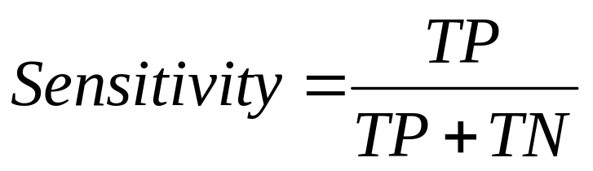
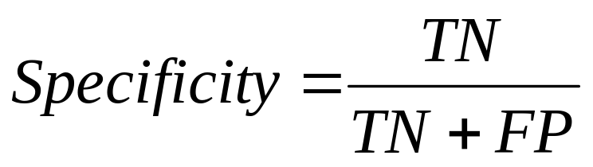
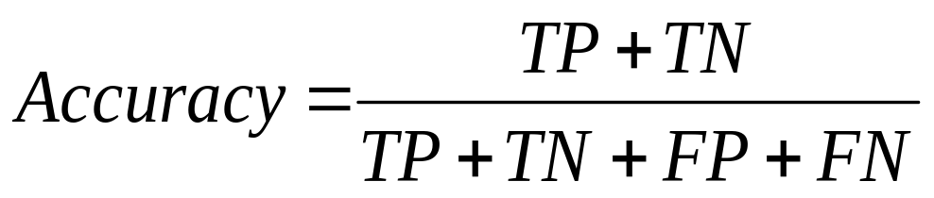
2. Accuracy measure
Sensitivity, specificity and overall accuracy (Q).
 |  | Actual condition
 |  | Present | Absent
Test result | Positive | True Positive | False Positive
 | Negative | False Negative | True Negative

Slide 6



3. Protein sample selection
Seven functional classes of proteins are used for testing the capability of our SVM program in the classification of proteins into functional classes.
  RNA-binding proteins
  protein homodimers
  drug absorption proteins
  drug delivery proteins
  drug excretion proteins
  class-I drug metabolizing enzymes
  class-II drug metabolizing enzymes
Swissprot
Protein Data Bank(PDB)
Drug ADME-associated protein database

Slide 7
4. Results
Test results for different protein functional classes.

